Slide 1
CIST 1423 / FALL 2026
XR PROJECT
LABS
WEEK 09 / INTERACTIVE VR
WEEK 10 / INTERACTIVE AR
WEEK 11 / SOUND + VFX
Chapters 5-9 in Unity
Five buildable labs. One path from interaction to evidence.
WEEK 12 / ADVANCED XR
WEEK 13 / BEST PRACTICES
Unity 2022.3.62f3 | Openable projects with screenshots

Slide 2
THE LEARNING ARC
Build, test, then make the evidence visible
Each lab adds one XR capability, then asks students to verify it in a fallback or target-device workflow.
09 / VR
10 / AR
11 / AUDIO
12 / GAZE
13 / UX
INTERACT
PLACE
FEEL
EXTEND
REVIEW
ASSESSMENT THREAD
Interaction diagram -> device/editor test -> observed result -> revision + peer review
CIST 1423 / UNITY XR LABS
02

Slide 3
WEEK 09 / CHAPTER 5
Interactive VR
Animate a prop with an Inspector event; reach another target with controller-ray C#.
STUDENTS BUILD
VERIFY BOTH PATHS
- UI Button -> Animator trigger -> one-shot pulse
- XR controller ray toggles a target color
- Mouse + Space provide desktop fallbacks
- No opaque assets or custom button script
1 Click the button; confirm the prop returns to Idle.
2 Aim and trigger; confirm target changes.
3 Repeat in mouse and keyboard fallback.
TURN IN
Two interactions + event-path diagram
CIST 1423 / UNITY XR LABS
03

Slide 4
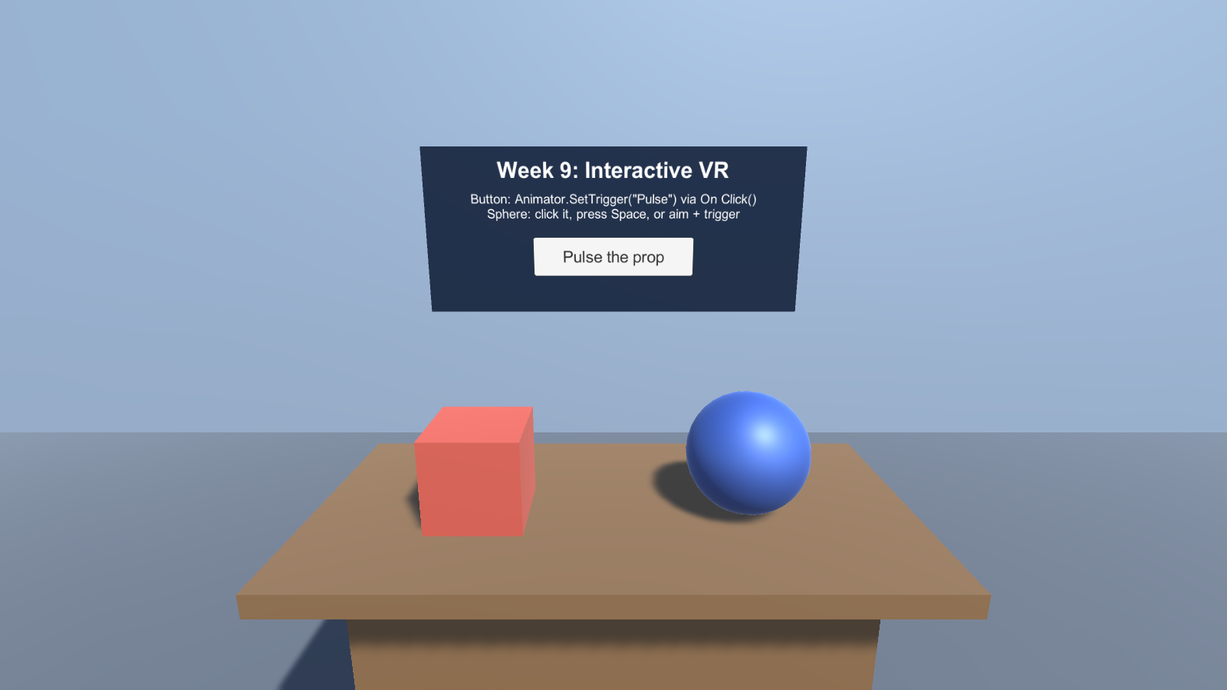
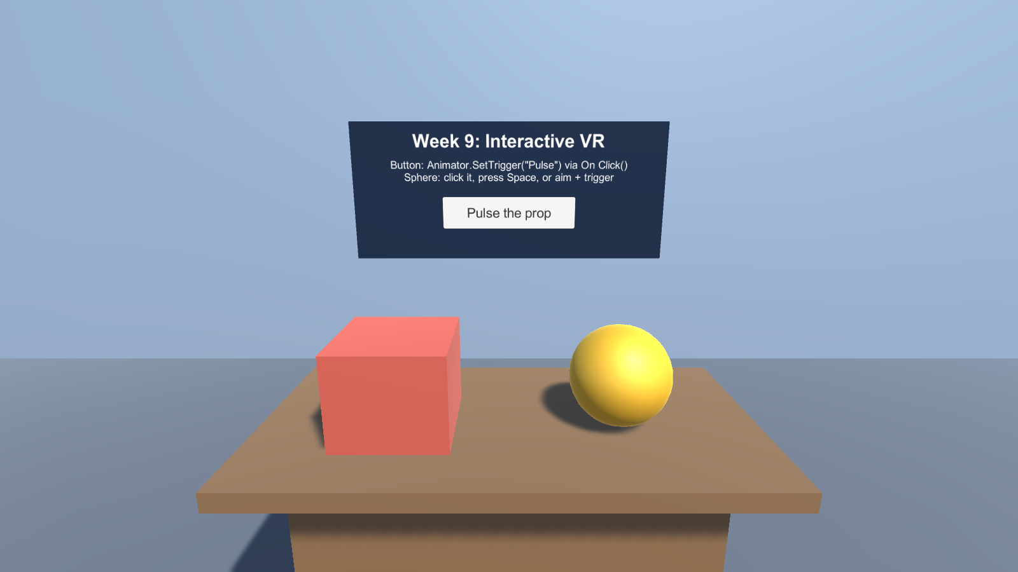
WEEK 09 / CHAPTER 5 / IN THE SCENE
One button, one ray, two event paths
Assets/Scenes/InteractiveVR.unity | 4 of 4 checks passed in a Windows build (no headset)
Start. Animated Prop (cube), Color Target (sphere), and the world-space button.
Both paths. The ray turned the sphere gold (C#); the button's On Click() pulsed the cube (Inspector event).
CIST 1423 / UNITY XR LABS
04

Slide 5
WEEK 10 / CHAPTER 6
Interactive AR
Build a tabletop placement flow with touch, C# selection, and a compact control UI.
STUDENTS BUILD
VERIFY THE LOOP
- Detect a plane and place a primitive prefab
- Tap to select; swap, delete, reset, toggle planes
- AR Foundation 5.1.5 with ARCore / ARKit providers
- Editor mouse + ground-plane fallback
1 Scan until a plane is tracked; place a prefab.
2 Select it and swap variants in place.
3 Check delete, reset, and plane visibility.
TURN IN
Device/Editor evidence + reflection
CIST 1423 / UNITY XR LABS
05

Slide 6
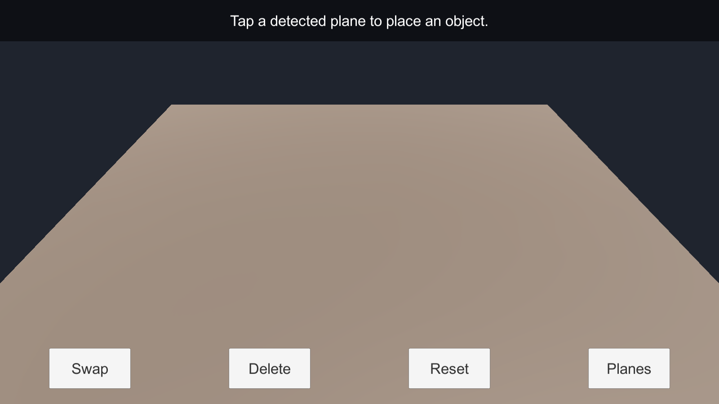
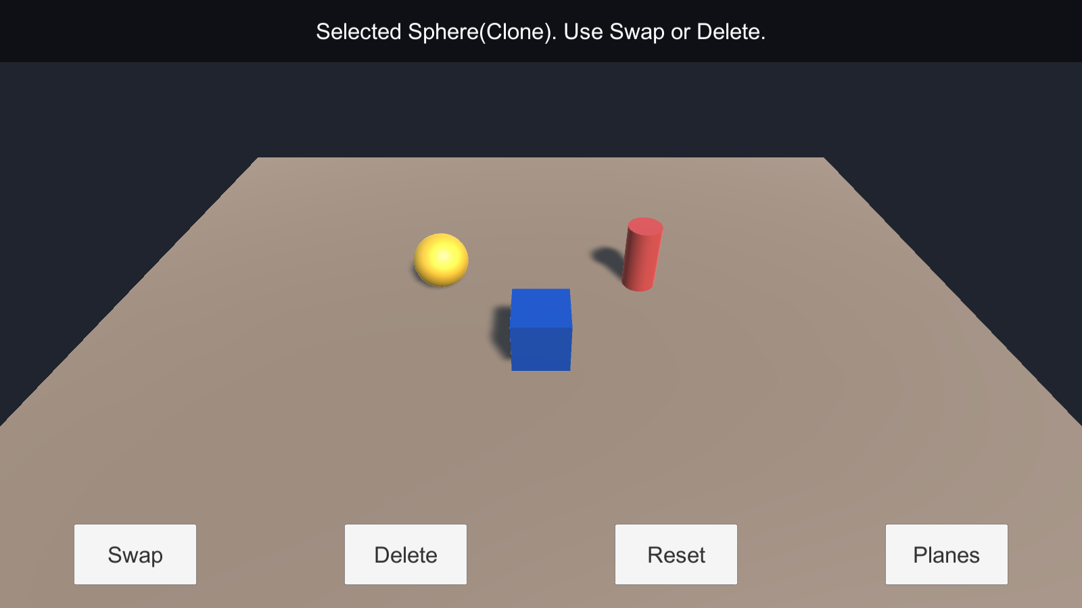
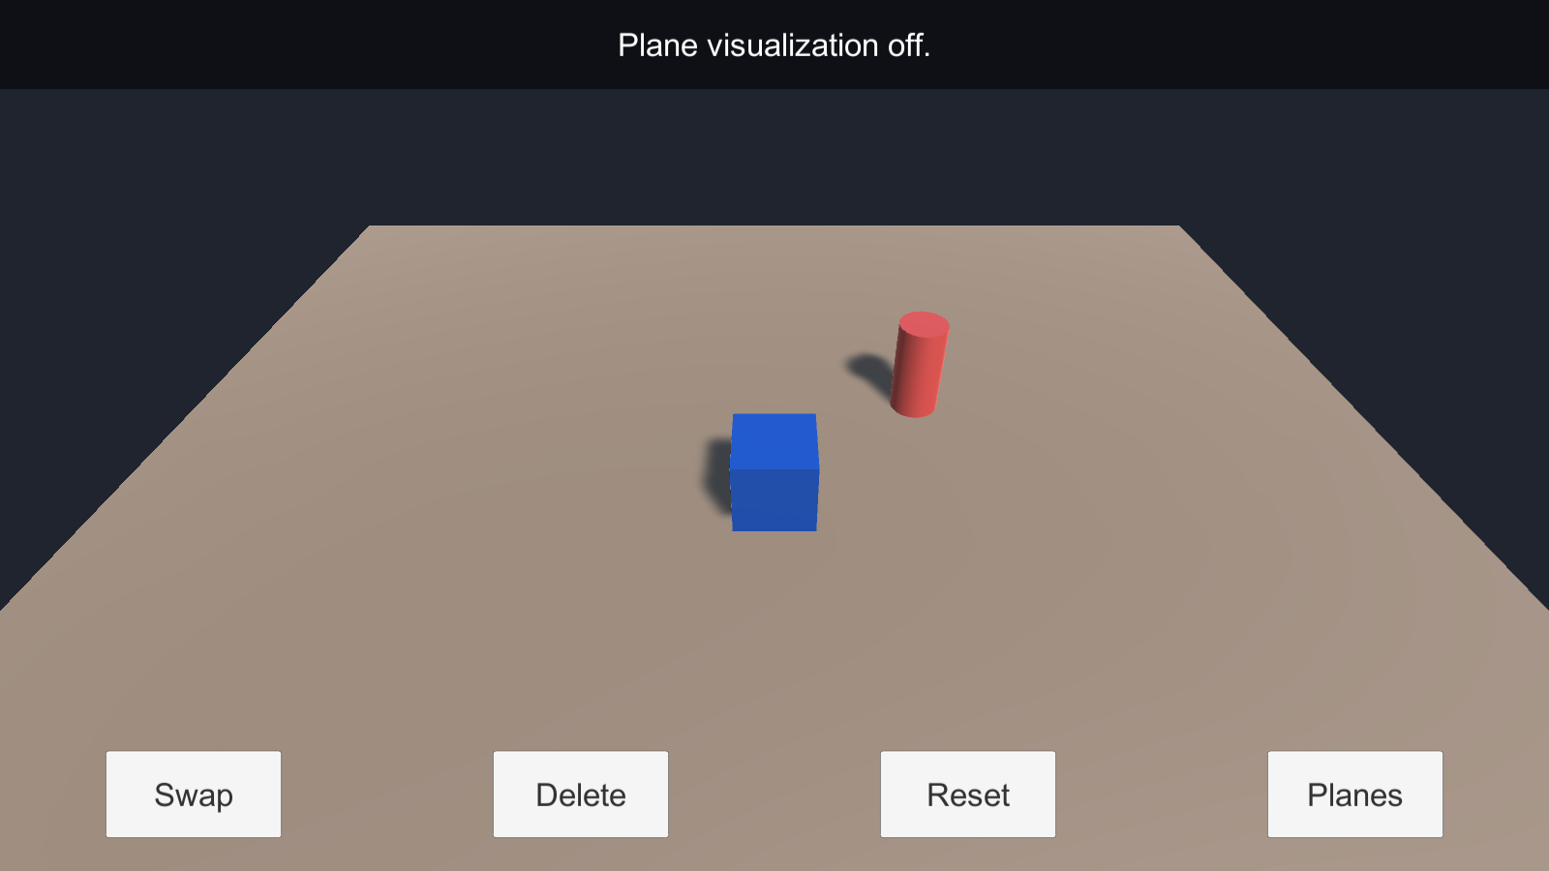
WEEK 10 / CHAPTER 6 / IN THE SCENE
Place, swap, select, delete
Assets/Scenes/InteractiveAR_EditorFallback.unity | 7 of 7 checks passed in a Windows build (no phone)
Start. The status bar asks for a tap.
Placed and swapped. Three variants; the sphere is selected (1.08x highlight).
After Delete. Only the selected sphere is gone. Reset returns to Cube.
CIST 1423 / UNITY XR LABS
06

Slide 7
WEEK 11 / CHAPTER 7
Sound and VFX
Resonance Garden turns distance and contact into spatial sound and particle feedback.
STUDENTS BUILD
LISTEN + OBSERVE
- Three procedural tones at distinct pitches
- AudioSources spatialized and routed to a mixer group
- Slider controls exposed feedback level
- Trigger entry plays a particle burst once
1 Enter each beacon; compare pitch and burst.
2 Move away; listen for distance attenuation.
3 Lower mixer to -30 dB; compare level.
TURN IN
Evidence of pitch, distance, and mix tests
CIST 1423 / UNITY XR LABS
07

Slide 8
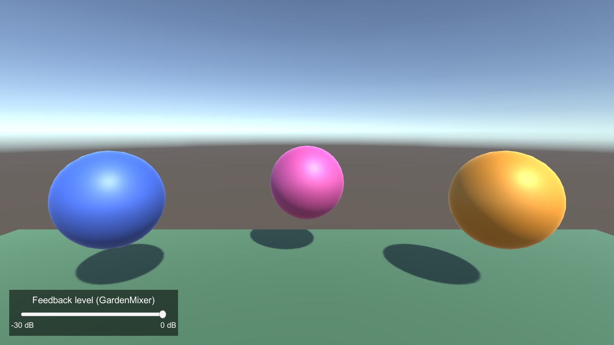
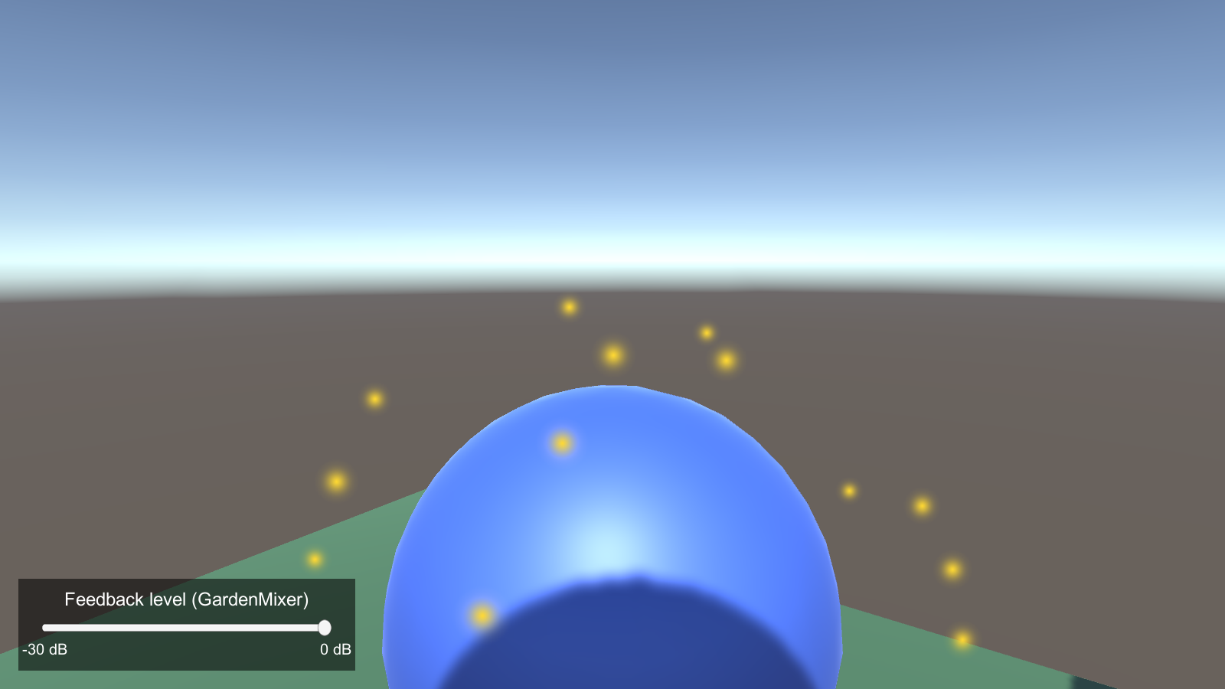
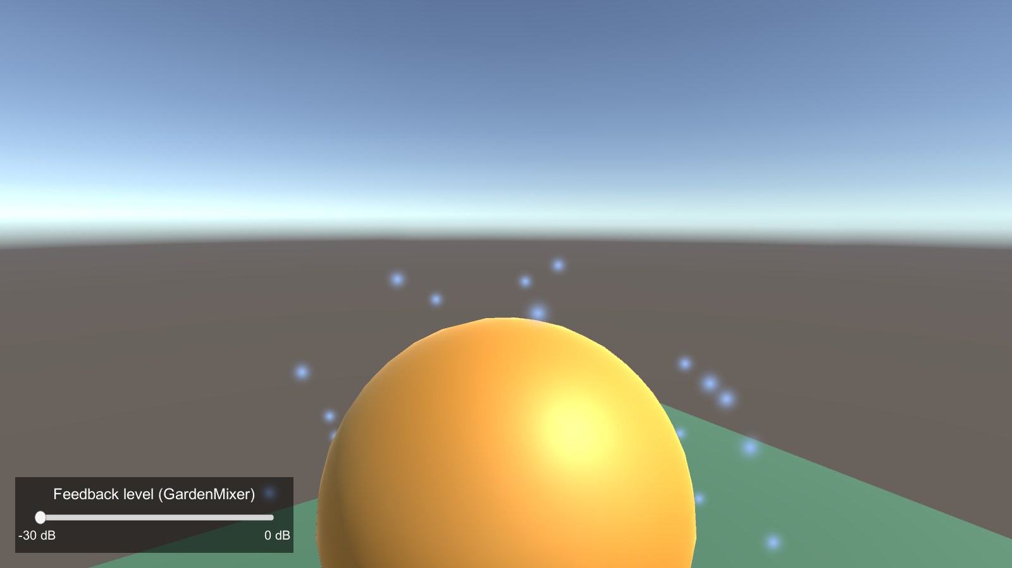
WEEK 11 / CHAPTER 7 / IN THE SCENE
Each beacon sounds, bursts, and mixes
Assets/Scenes/ResonanceGarden.unity | 16 of 16 checks passed in a Windows build
Start. Three beacons tuned to C4, A4 and E5.
Entering BeaconLow. One burst and one tone (heard at 270 Hz). No retrigger inside.
Slider at -30 dB. Burst still plays; tone is 32.5 dB quieter at the same pitch.
CIST 1423 / UNITY XR LABS
08

Slide 9
WEEK 12 / CHAPTER 8
Advanced XR: head-gaze dwell
A camera ray and dwell timer create a hardware-neutral gaze interaction.
STUDENTS BUILD
STATE THE LIMIT
- Look at a collider target for 1.2 seconds
- Fill indicator tracks dwell progress
- Completion event drives selection feedback
- Mouse-position fallback works without headset
1 Leave early; progress resets without selection.
2 Hold gaze; event fires once at completion.
3 Report device and package versions tested.
TURN IN
Test checklist + limitation note (not multiplayer)
CIST 1423 / UNITY XR LABS
09

Slide 10
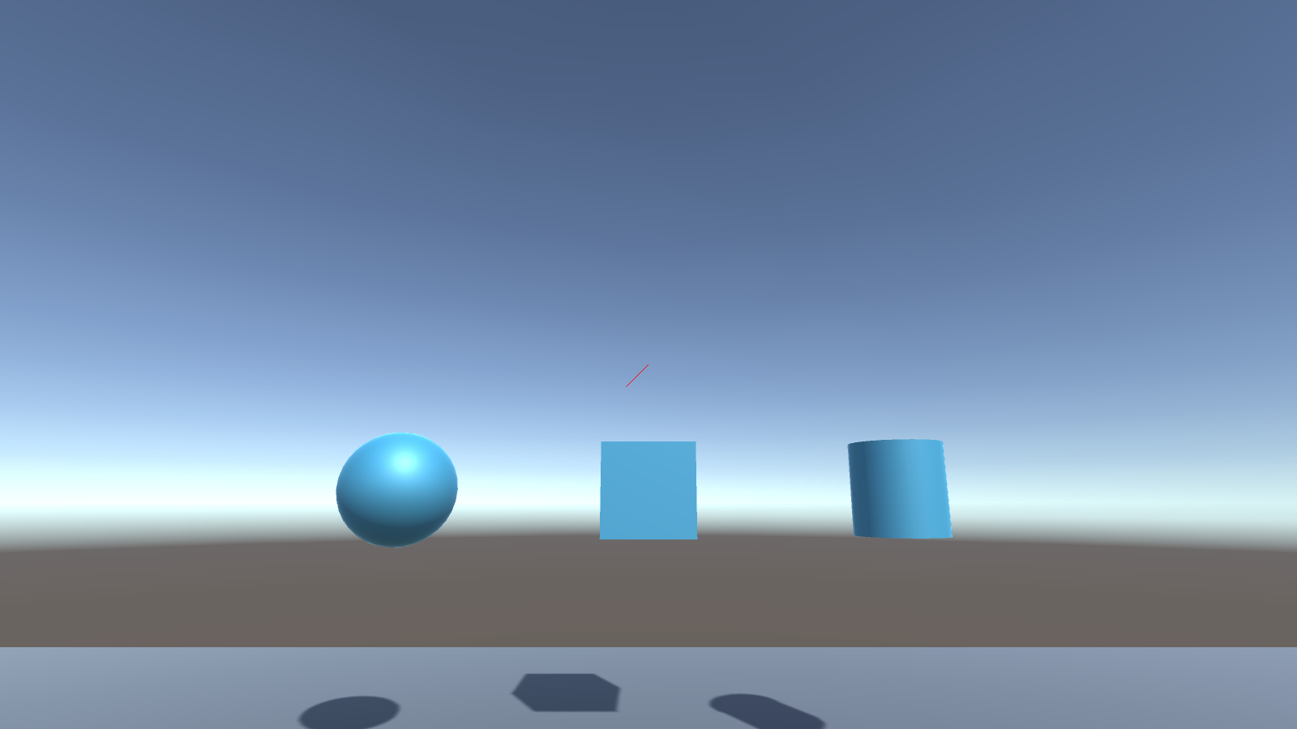
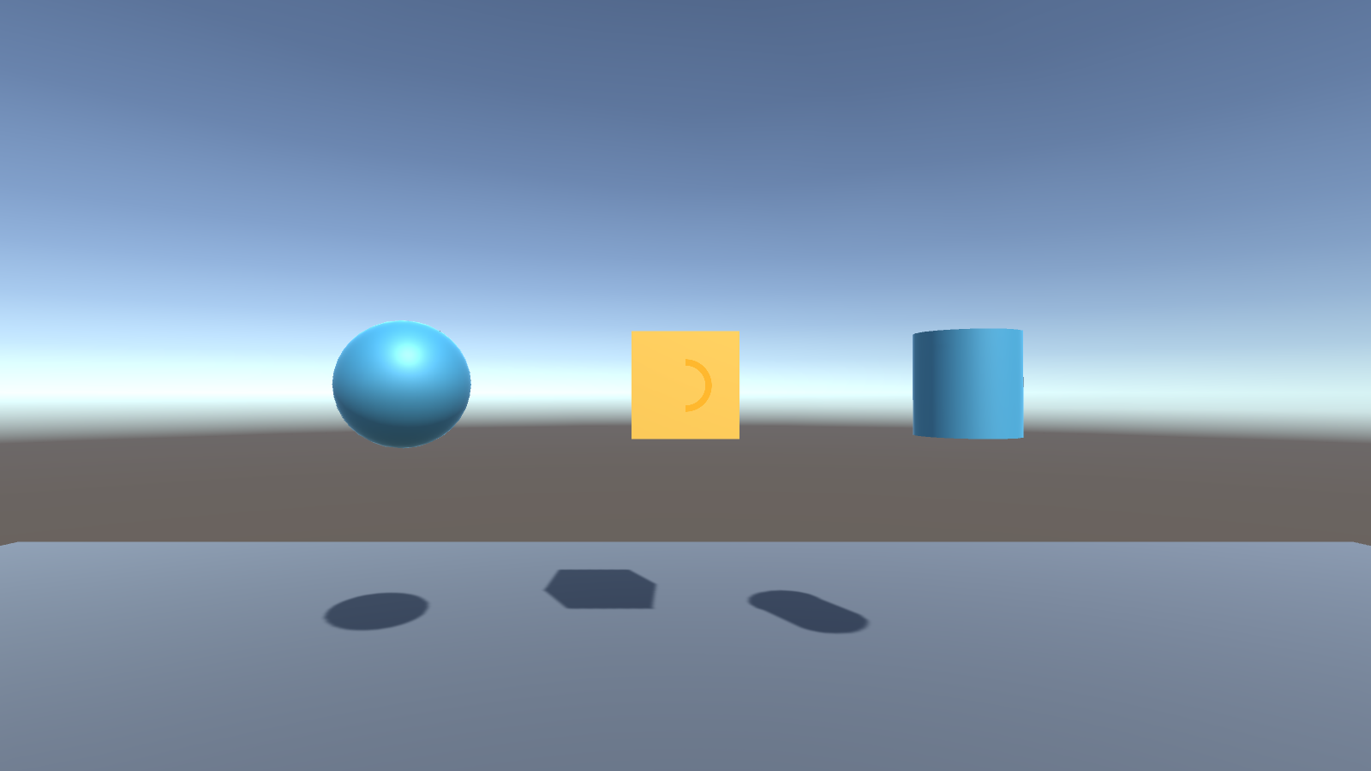
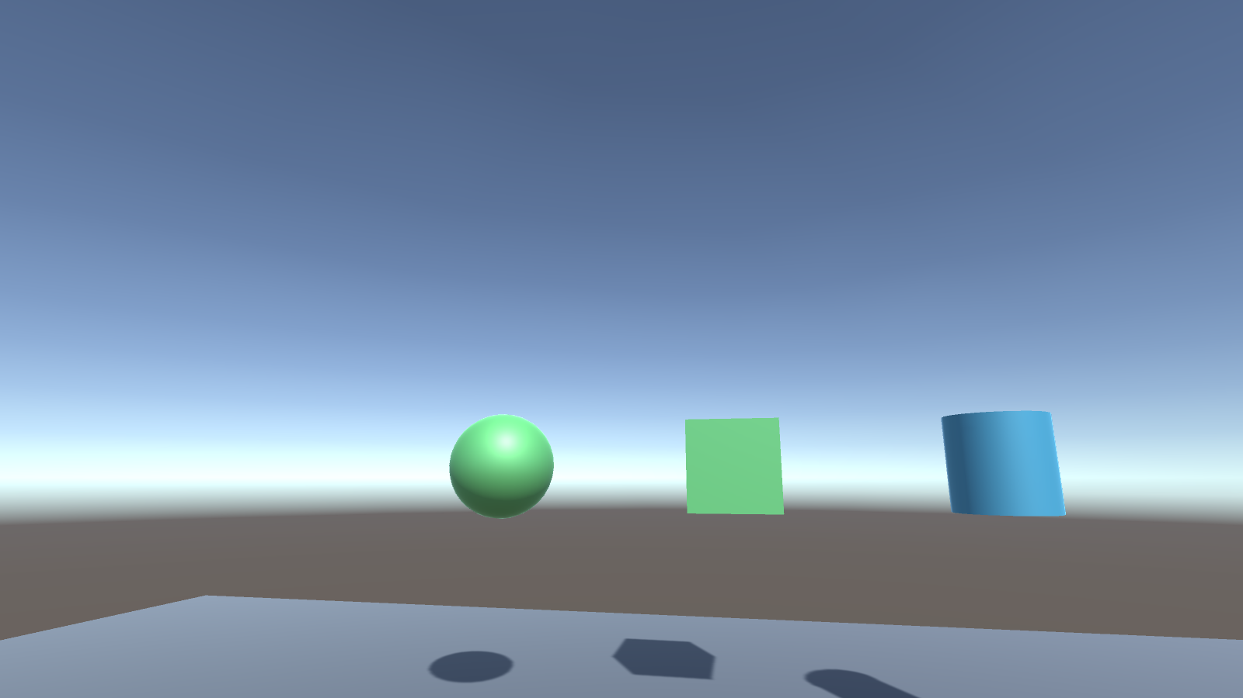
WEEK 12 / CHAPTER 8 / IN THE SCENE
Gaze fills the ring, then selects
Assets/Scenes/GazeDwell.unity | 5 of 5 checks passed in a Windows build (head gaze simulated, no headset)
Idle. Three targets; nothing is gazed at.
0.6 s in. Gaze color and a half-full ring. Looking away now cancels.
Selected. 1.2 s dwells on the cube and sphere; the event fired once.
CIST 1423 / UNITY XR LABS
10

Slide 11
WEEK 13 / CHAPTER 9
Comfort, validation, and review
Apply lifecycle thinking to a prior project; the helper records observations, not comfort certification.
STUDENTS BUILD
EVIDENCE OVER CLAIMS
- Review locomotion, reach, UI, access, recovery, performance
- Write observation -> impact -> change -> retest
- Compare toolkits using dated primary sources
- Make one focused change and review a peer PR
1 Test common tasks on intended setup.
2 Record before/after result and limitations.
3 Reviewer checks evidence and regression risk.
TURN IN
Revised scene + report + toolkit note + peer review
CIST 1423 / UNITY XR LABS
11

Slide 12
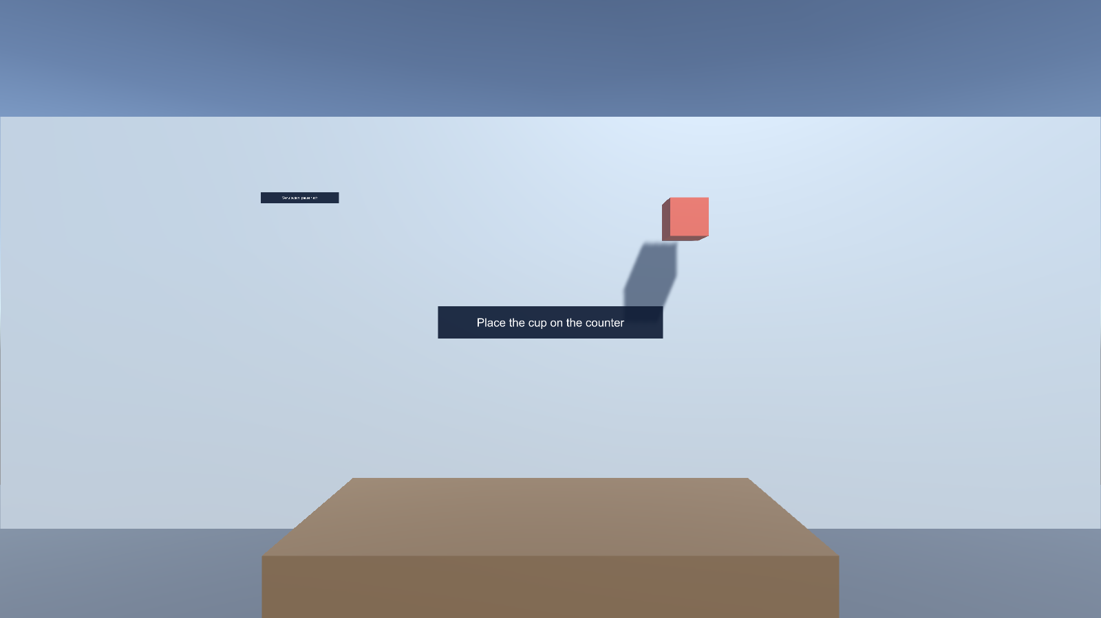
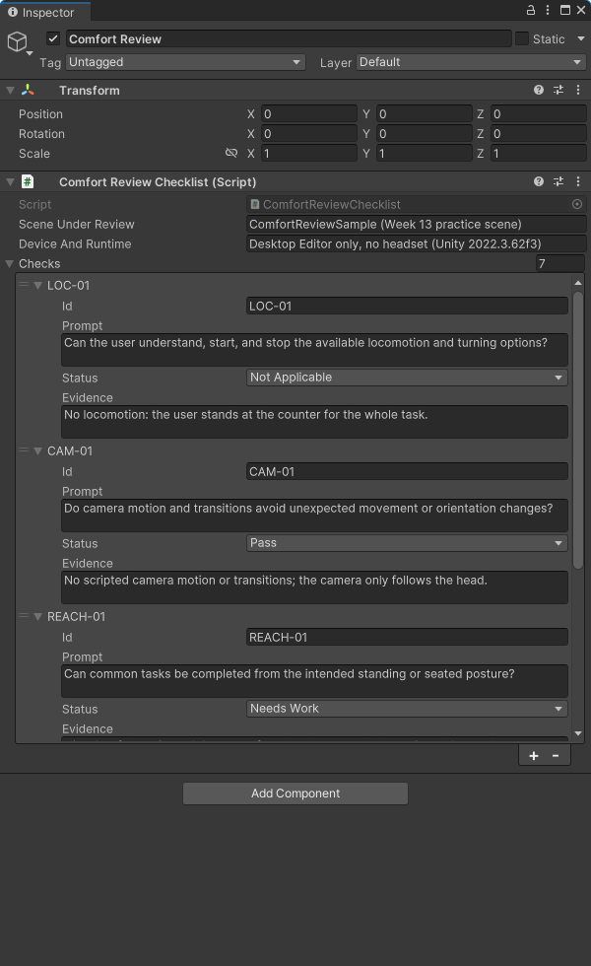
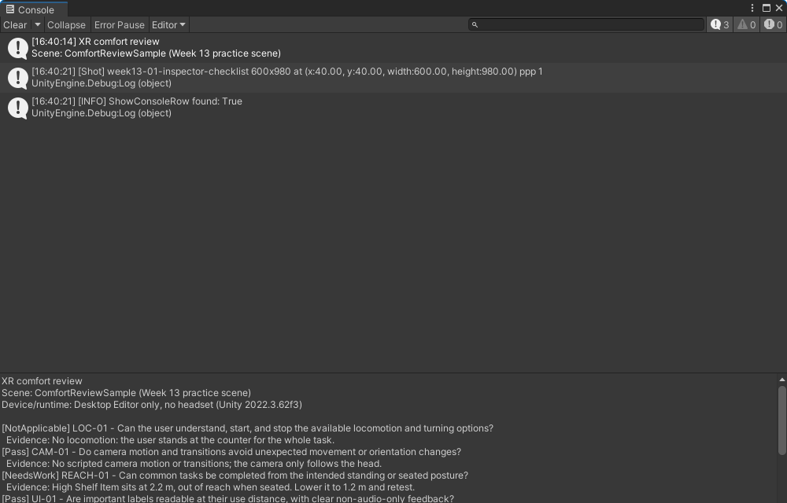
WEEK 13 / CHAPTER 9 / IN THE SCENE
A practice room with problems to find
Assets/Scenes/ComfortReviewSample.unity | starter checks seeded and report verified in Unity 2022.3.62f3
Printed report. Example run: Pass 2, Needs Work 2, N/A 1, Not Run 2.
Practice room. A task label, a shelf item at 2.2 m, and an exit sign too small to read from the start point.
Inspector. Starter checks with example statuses and evidence.
CIST 1423 / UNITY XR LABS
12

Slide 13
THE FIVE PROJECTS, ONE PRACTICE
Make every claim testable.
The sequence moves from authored interaction to device-aware validation and collaborative review.
09
Input and event paths
10
Placement and selection
11
Spatial feedback
12
Gaze and dwell
13
Comfort and iteration
START HERE
Open a Week-09 to Week-13 folder in Unity Hub; each has a ready-made scene and a README with tests.

